Slide 1
With Cognitive Services
“Out of the Box Machine Learning”
Justine Cocchi
@JustineCocchi

Slide 2

Agenda
Overview of Cognitive Services
Hands on Workshop

Slide 3
What are Cognitive Services?
What are Cognitive Services?
Prebuilt machine learning models to quickly add context and deeper understanding to your apps

Slide 4


Cognitive Services
microsoft.com/cognitive
Vision
Speech
Language
Knowledge
Search
Computer Vision
Custom Recognition
Bing Spell Check
Academic Knowledge
Bing
Web Search
Emotion
Speaker Recognition
Linguistic Analysis
Entity Linking
Bing
Image Search
Face
Speech
Language Understanding
Knowledge Exploration
Bing
Video Search
Video
Translator
Text Analytics
QnA Maker
Bing
News Search
WebLM
Bing
Autosuggest
Notes:
Go to Microsoft.com/cognitive → show Emotion API Reference

Slide 5


Slide 6
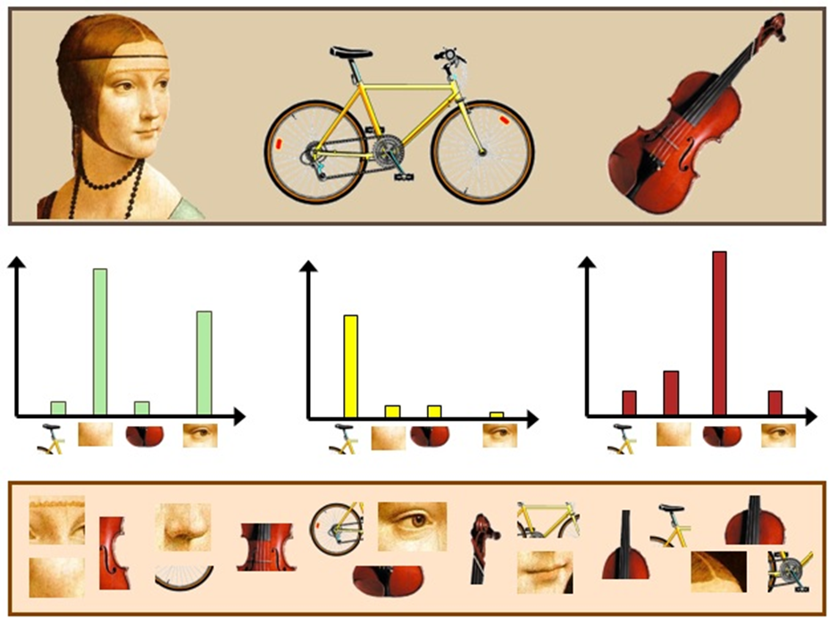
How?
Bag of (visual) words

Slide 7



“But I’m not a data scientist…”

Slide 8

Why?
Easy, flexible and tested

Slide 9

Vision APIs

Slide 10
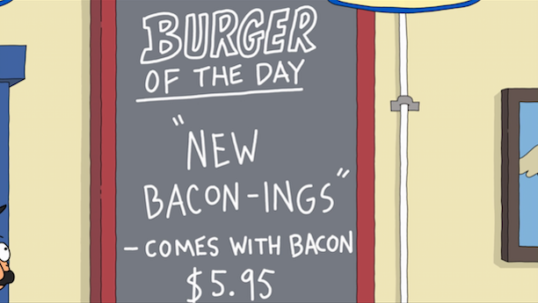
Computer Vision - OCR
TEXT:
OF THE DAY
NEW
BACON -INGS
- COMES WITH BACON
JSON:
{
"language": "en",
"textAngle": -1.8000000000000336,
"orientation": "Up",
"regions": [
{
"boundingBox": "137,68,261,274",
"lines": [
{
"boundingBox": "167,68,183,35",
"words": [
{
"boundingBox": "167,75,41,28",
"text": "OF"
},
{
"boundingBox": "223,72,56,25",
"text": "THE"
},
{
"boundingBox": "294,68,56,29",
"text": “DAY"
}
]
};
. . .

Slide 11
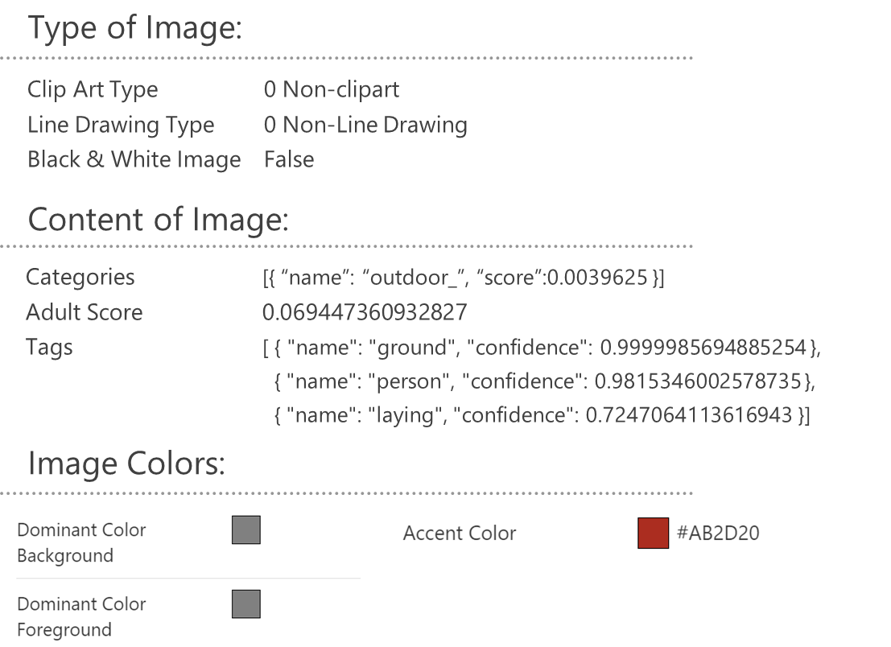

Computer Vision – Analyze Image

Slide 12

Face APIs

Slide 13

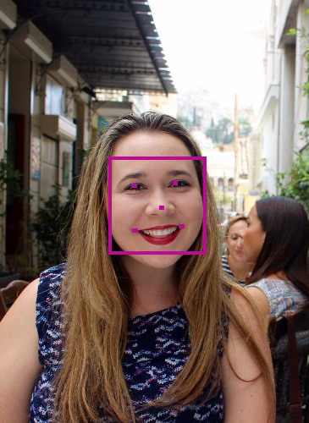

Face Analytics
[
{
"faceId": "5a89cea3-1451-42ff-a875”
"faceRectangle": {
"width": 269,
" height": 269,
"left": 303,
"top": 434
},
"faceLandmarks": {
"pupilLeft": {
"x": 374.1,
"y": 514.6
},
"pupilRight": {
"x": 486,
"y": 506.1
},
. . .
“faceAttributes": {
"age": 31.2,
"gender": "female",
"headPose": {
"roll": -6.2,
"yaw": 8.6,
"pitch": 0
},
"smile": 0.238,
. . .
Notes:
https://www.mymoustache.net

Slide 14
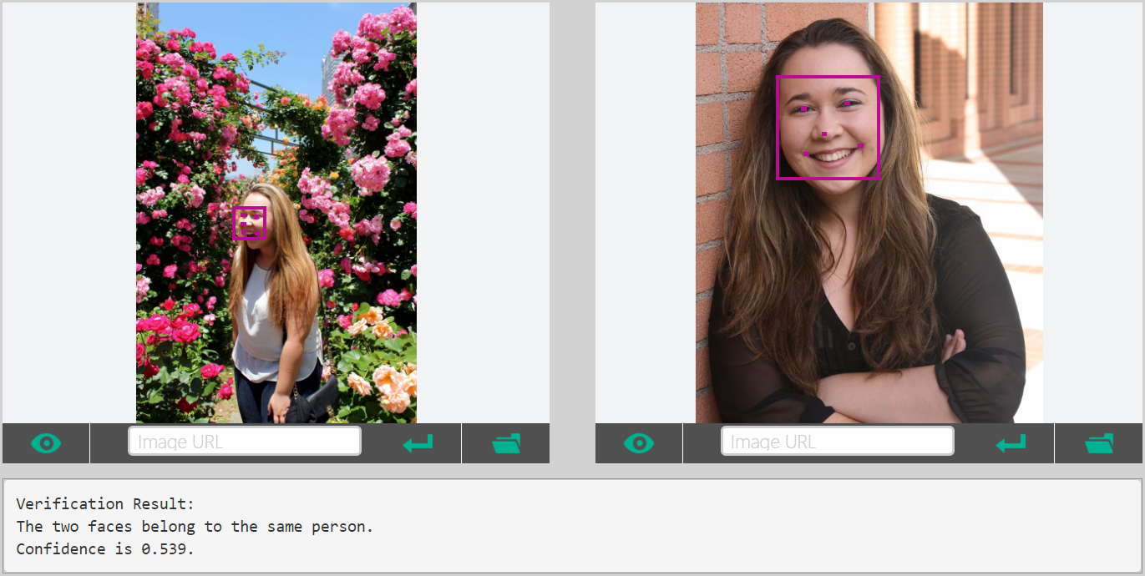
Facial Verification
.
.
.
.
.
.
.

Slide 15

Speech and Text APIs

Slide 16

Voice Recognition
es-ES
de-DE
fr-FR
en-GB
it-IT
en-US
zh-CN
Converts spoken audio to text
Same backend which powers Cortana
Support for 7 languages at launch

Slide 17
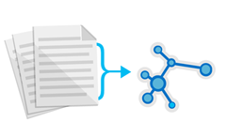



Text Analytics
de-DE
es-ES
fr-FR
en-GB
it-IT
en-US
zh-CN
Sentiment analysis
Key phrase extraction
Language detection for 120 languages
Notes:
Whatnottowatch.azurewebsites.net

Slide 18

LUIS Language Understanding Intelligent Service

Slide 19
Language Understanding Intelligent Service
Lets you understand what your users are saying
Seamless integration with Speech Recognition
A few examples are enough to deploy an application
LUIS learns over time
Define
Concepts
Provide
Examples
Deploy
Active Learning

Slide 20
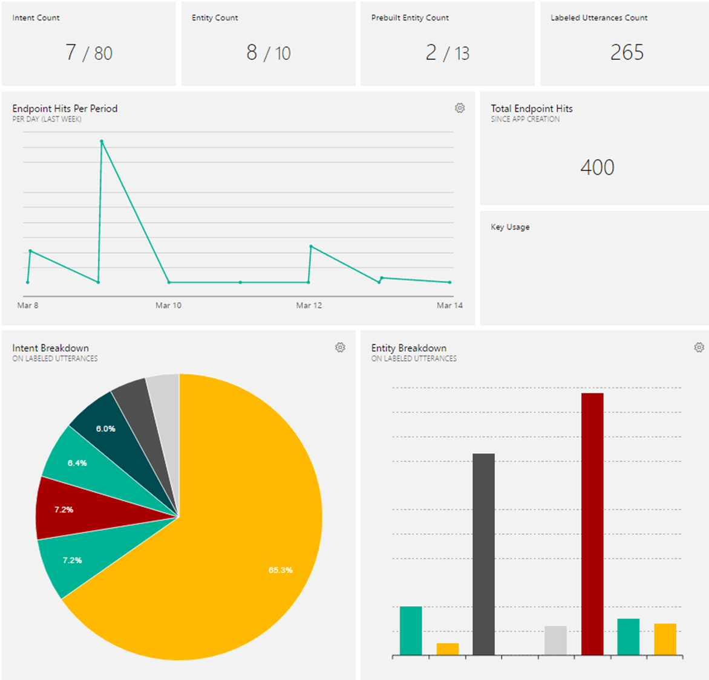
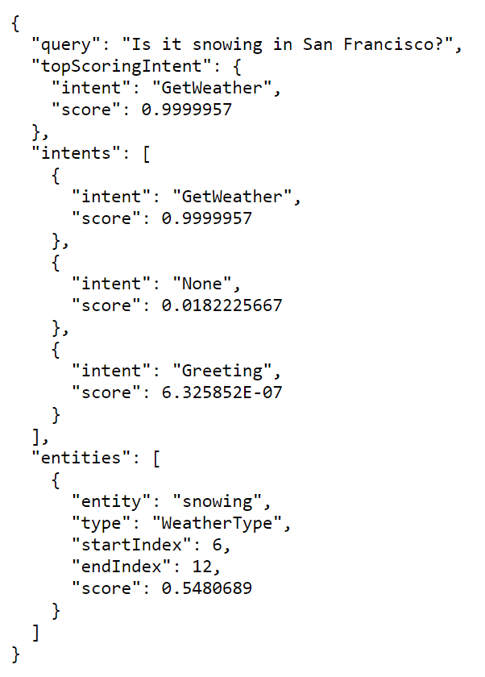
Notes:
Luis.ai

Slide 21
Microsoft Cognitive Services
A portfolio of REST APIs and SDKs which enable developers to write applications which understand the content within the rapidly growing set of multimedia data

Slide 22

Microsoft Cognitive Services
Combine APIs to Make Even Smarter Apps
Notes:
Murphy bot demo on skype

Slide 23
Workshop
microsoft.com/cognitive
Start coding
Lets see it in action!

Slide 24





What is .NET
Core?

Slide 25
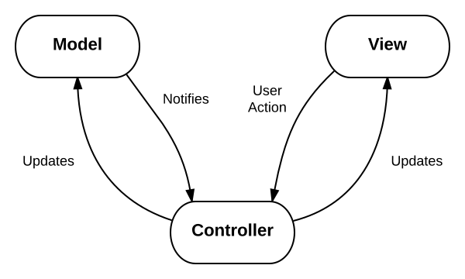
Lets take a look at the code
This design pattern is called MVC and is very popular for web applications
Model: The data for your application
View: The physical pages and layout of your application
Controller: The business logic of your application

Slide 26
Install the Prereqs
Install .NET Core at dot.net
There are extra steps for installing on Mac
microsoft.com/net/core#macos
Install a text editor like Visual Studio Code (works on PC, Mac, or Linux)
code.visualstudio.com

Slide 27
Download or clone the repo
Aka.ms/CogServDemo
‘dotnet restore’
‘dotnet run’
Navigate to http://localhost:5000 in your browser
FYI- it’s not supposed to do anything yet!

Slide 28
Get Emotion Recognition API Key
Microsoft.com/cognitive
“Get Started for Free” and sign in with social auth
You must verify your account before subscribing to a trial
Subscribe to new Free Trials
Check Emotion – Preview and agree to the terms
Copy “Key 1” and save it for later

Slide 29
Make the API Call
Copy the content of CodeSnippets/MakeRequest.txt to the Controllers/HomeController.cs file
Enter your subscription key in place of
Uncomment the call to MakeRequest() on line 29

Slide 30
Verification
Set a breakpoint on the function call and run the project
The value of the ‘results’ variable is the JSON returned by Cognitive Services as a string!
Our site hasn’t visibly changed yet

Slide 31
Parse the Result to find the Top Emotion
Copy content of CodeSnippets/TopEmotion.txt to the Models/EmotionSet.cs file, inside of the Scores class
This new function replaces the empty Max() function already in the Scores class
Copy the content of CodeSnippets/ParseResults.txt to the Controllers/HomeController.cs file Uncomment the call to ParseResults() on line 32

Slide 32
Verification
Set a breakpoint on the function call and run the project
The value of the ‘topEmotion’ variable should be the top emotion
Site still hasn’t visibly changed yet

Slide 33
Make the Suggestion and Display Results
Copy the content of CodeSnippets/MakeSuggestion.txt to the Controllers/HomeController.cs file
Uncomment the call to MakeSuggestion() on line 35
Delete the temporary ‘return View()’ on line 41 and uncomment ‘return RedirectToAction()’ on line 38
This is how we will display the results on our site

Slide 34
Verification
Now when we enter a link to a photo and press submit, the site should redirect to a results page, displaying an image based on the top emotion found in the photo!

Slide 35
Customize your Site
Change the images and descriptions for each emotion in MakeSuggestion()
In .NET Core, all static files are stored in the wwwroot/images folder so be sure to put your images here in order for them to be displayed

Slide 36
Customize your Site
Change the way you use the API
Doesn’t have to be based on the top emotion
Maybe you only care about the bottom emotion or a particular emotion’s score
Get creative!

Slide 37
Customize your Site
Add additional API calls
Mix and match the Cognitive Services to make even more compelling applications

Slide 38

Add Cognitive Services APIs to Your Own Apps
Get subscription key
Make API call
Parse JSON response
Do something with the results

Slide 39
Justine.Cocchi@Microsoft.com
@JustineCocchi

